Slide 1
Macroeconomic Equilibrium

Slide 2
Real Output and Price Level
Equilibrium occurs when the quantity of real output supplied is equal to real output demanded
Real Output Qf
Price Level PLf
Price Level
AS
PLf
AD
Qf
Real GDP

Slide 3
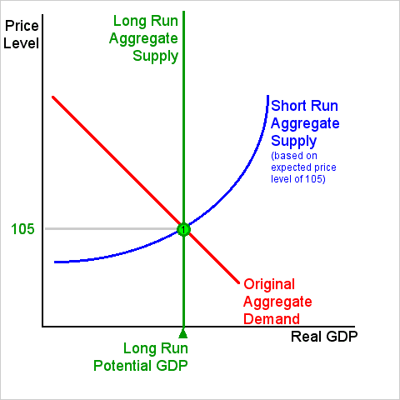
Short and Long Run
Short run EQ occurs when the SRAS intersects with the SRAD
Shows the short term effects of the
Market and business decisions.
Some factors are variable and others are
fixed

Slide 4
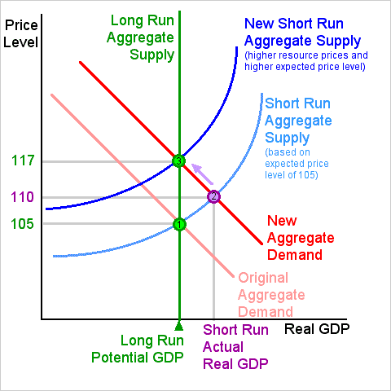
Short and Long Run
Long Run EQ is the period when the general price level, contractual wage rates, and expectations adjust fully to the state of the economy, in contrast to the short run when these variables may not fully adjust.

Slide 5
Actual vs Full Employment Output
Full employment output is the theoretical output of a nation that is producing to its full extent.
Full utilization of all equipment and machinery.
100% employment
This shows how much a country can theoretically produce, however actual employment output is a percentage of the total possible output.

Slide 6
Actual vs Full Employment Output
Actual unemployment output show the true production capabilities of a nation.
Actual unemployment takes into account the percent of total equipment and machinery being utilized as well as the percent of the total work force that is employed.
By using these percentages, the total percent of full employment output can be determined.

Slide 7
Economic Fluctuations
Economies experience expansionary and recessionary periods
Caused by disturbances in the economy
inflation & deflation
shifts in AD or AS
A surge in spending
Changes in technology
changes in interest rates
basically, AD and AS shifters cause economic fluctuations

